Slide 1
Collaborative Device and Data Management in the Domestic Internet of Things
Group 26: Mario Jose George Garcia, Thomas Seaman, Ian Nkwocha, Berk Demir, Zaki Kalha, Buluthan Bozkurt

Slide 2
ABOUT OUR TEAM
A Short Overview Of Our Roles And What We Bring To This Project
Team Leader: Mario
Team Admin: Thomas
Git Master: Ian
Team Member: Berk
Team Member: Buluthan
Team Member: Zaki

Slide 3
PROPOSED APPROACH - PLATFORMS
Raspberry Pi
Python Scripts To Control Sensors
Object Oriented Approach
Programming Sensor Modules As Objects Which Interface With a Device object
Modules Split Up Between Pairs
GUI
HTML/CSS/JS
Python - Kivy

Slide 4
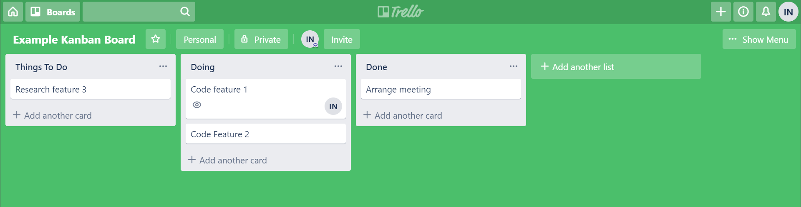
PROPOSED APPROACH - MANAGEMENT
Bi-Weekly Meetings
Source New Requirements
Making Adjustments/ Additions To Kanban Board
Kanban Board
Dividing Up And Tracking Tasks
Paired Programming To Reduce Skill Deficiencies
GitLab
Version Control and Backups
Automatic Integration Testing
University Email And Calendar
Planning meetings & Liaison

Slide 5
MILESTONES
October-December Cycle
Gather requirements and specs ( November)
Finalize pre-development documentation & begin development (November)
Basic Prototype (December)
January-March Cycle
Finish minimal viable product, get feedback and decide on potential extensions (March)
Begin product extensions (March)
March-May Cycle
Finish final product and get feedback (April)

Slide 6
WHY WE ARE SUITABLE
Technical skills
Experience using raspberry pi
Git and Junit testing
MySQL for storing users
Studied Electronics
Soft Skills
Working in teams, communication
Team Leadership skills (Mario)
Project Management Skills
Knowledge Of How To Use Scrum
Experience Using Kanban Board (Berk, Ian)
Our Academic Backgrounds
Development Of Application For Client In IB Computing (Ian)
Electrical Engineering Summer Credit Course at Harvard (Berk)
IB Physics Extended Essay on Electronics (Berk)
Our Personal Experience
Owning Raspberry Pi (Ian)
Researching Risks Of IoT Devices (Mario)
Mobile App Development Internship (Zaki)

Slide 7
SUMMARY
Our Key Skills and Suitability
Our Approach
Why We Would Like This Project

